Slide 1
File Handling

Slide 2
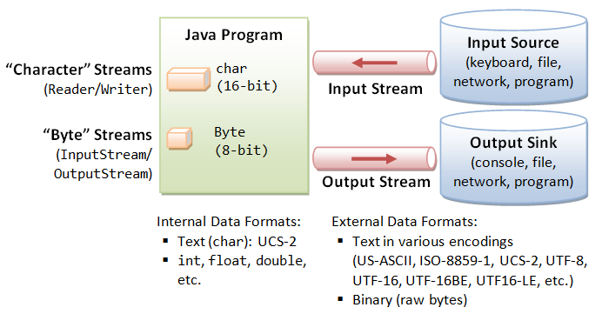
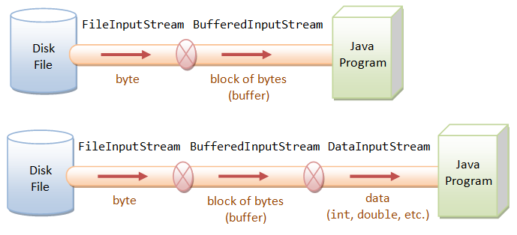
Stream I/O in Standard I/O (java.io Package)

Slide 3
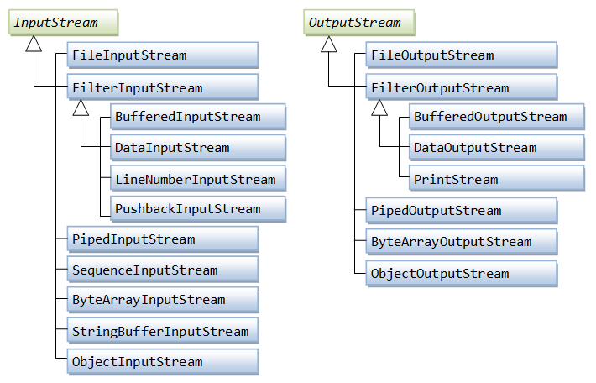
. Byte-Based I/O & Byte Streams

Slide 4
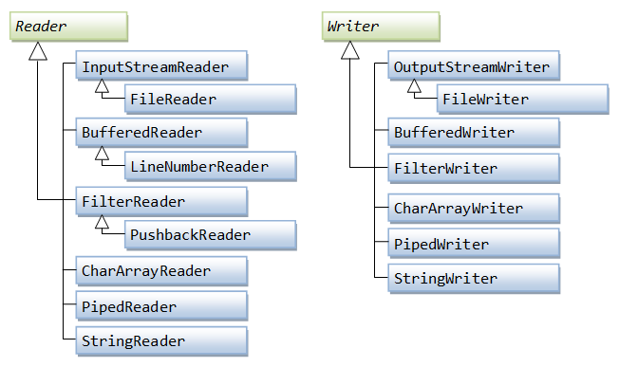
Character-Based I/O & Character Streams

